Slide 1
DEBUGGING JAVASCRIPT
LIKE A BOSS
Stephanie Brubaker, FullStory

Slide 2
I write a *lot* of UI code.
Notes:
Why do I care about debugging JS?
I’m a full-stack developer, but frontend is what I’m passionate about

Slide 3

I work at

Slide 4

Notes:
FullStory is like a DVR for your website
We capture the DOM and all mutations
We see some wonky stuff that we have to debug :)

Slide 5
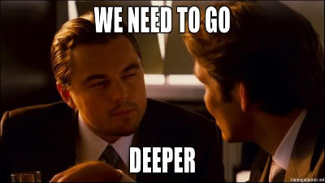

Slide 6
THE BEST DEFENSE IS A GOOD OFFENSE
Notes:
I was told that the best place for a sports metaphor is a dev conference.

Slide 7
THE BEST DEFENSE IS A GOOD OFFENSE
Don’t write JavaScript
Notes:
wut?
other variants on JS provide features that will help you write better code

Slide 8
TypeScript
Static type analysis
Abstract classes + Interfaces
Compile-time checks
Notes:
JS uses prototypes to achieve something class-like; TypeScript has proper classes, interfaces, public/private vars, ...

Slide 9
Alternatives
JSX
GWT (Java to JS)
CoffeeScript

Slide 10
THE BEST DEFENSE IS A GOOD OFFENSE
Use CSS to simplify code

Slide 11
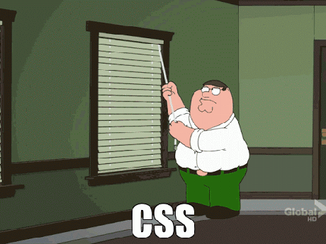
THE BEST DEFENSE IS A GOOD OFFENSE

Slide 12
USE CSS TO SIMPLIFY CODE
Javascript:
<div id="myDiv" onmouseover="document.getElementById('myDiv').style.background = ‘red’"
onmouseout="document.getElementById('myDiv').style.background = ‘’">
Mouse over me!
</div>
Notes:
SASS and CSS3 make CSS really powerful for adaptive styling changes

Slide 13
USE CSS TO SIMPLIFY CODE
CSS:
<div class=”myDiv”>
Mouse over me!
</div>
.myDiv:hover {
background-color: red;
}
Notes:
this is a contrived example, but CSS can handle some pretty sophisticated rendering logic
SASS and CSS3 make CSS really powerful for adaptive styling changes

Slide 14
THE BEST DEFENSE IS A GOOD OFFENSE
Optimize your environment

Slide 15
OPTIMIZE YOUR ENVIRONMENT
Run a compiling server
Gulp
Grunt
Notes:
Gulp or Grunt:
Compiles Sass to CSS
Refreshes the browser automatically whenever you save a file
Find an IDE with tooling that makes it harder to write bugs (Eclipse and WebStorm/IntelliJ) or a beefy editor like Sublime
fast, have syntax highlighting, code completion, search, refactoring

Slide 16
OPTIMIZE YOUR ENVIRONMENT
Use an IDE
IntelliJ/WebStorm
Eclipse
...or a good editor
Sublime
Notes:
Gulp or Grunt:
Compiles Sass to CSS
Refreshes the browser automatically whenever you save a file
Find an IDE with tooling that makes it harder to write bugs (Eclipse and WebStorm/IntelliJ) or a beefy editor like Sublime
fast, have syntax highlighting, code completion, search, refactoring

Slide 17
THE BEST DEFENSE IS A GOOD OFFENSE
Change languages
Use CSS
Optimize your environment

Slide 18
DEV TOOLS ARE YOUR FRIEND

Slide 19
DEV TOOLS ARE YOUR FRIEND
Add source maps

Slide 20
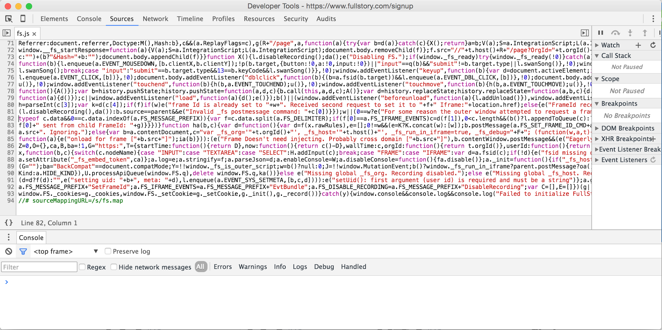
DEV TOOLS ARE YOUR FRIEND
Notes:
-- make it clear that minified code is usually on prod

Slide 21
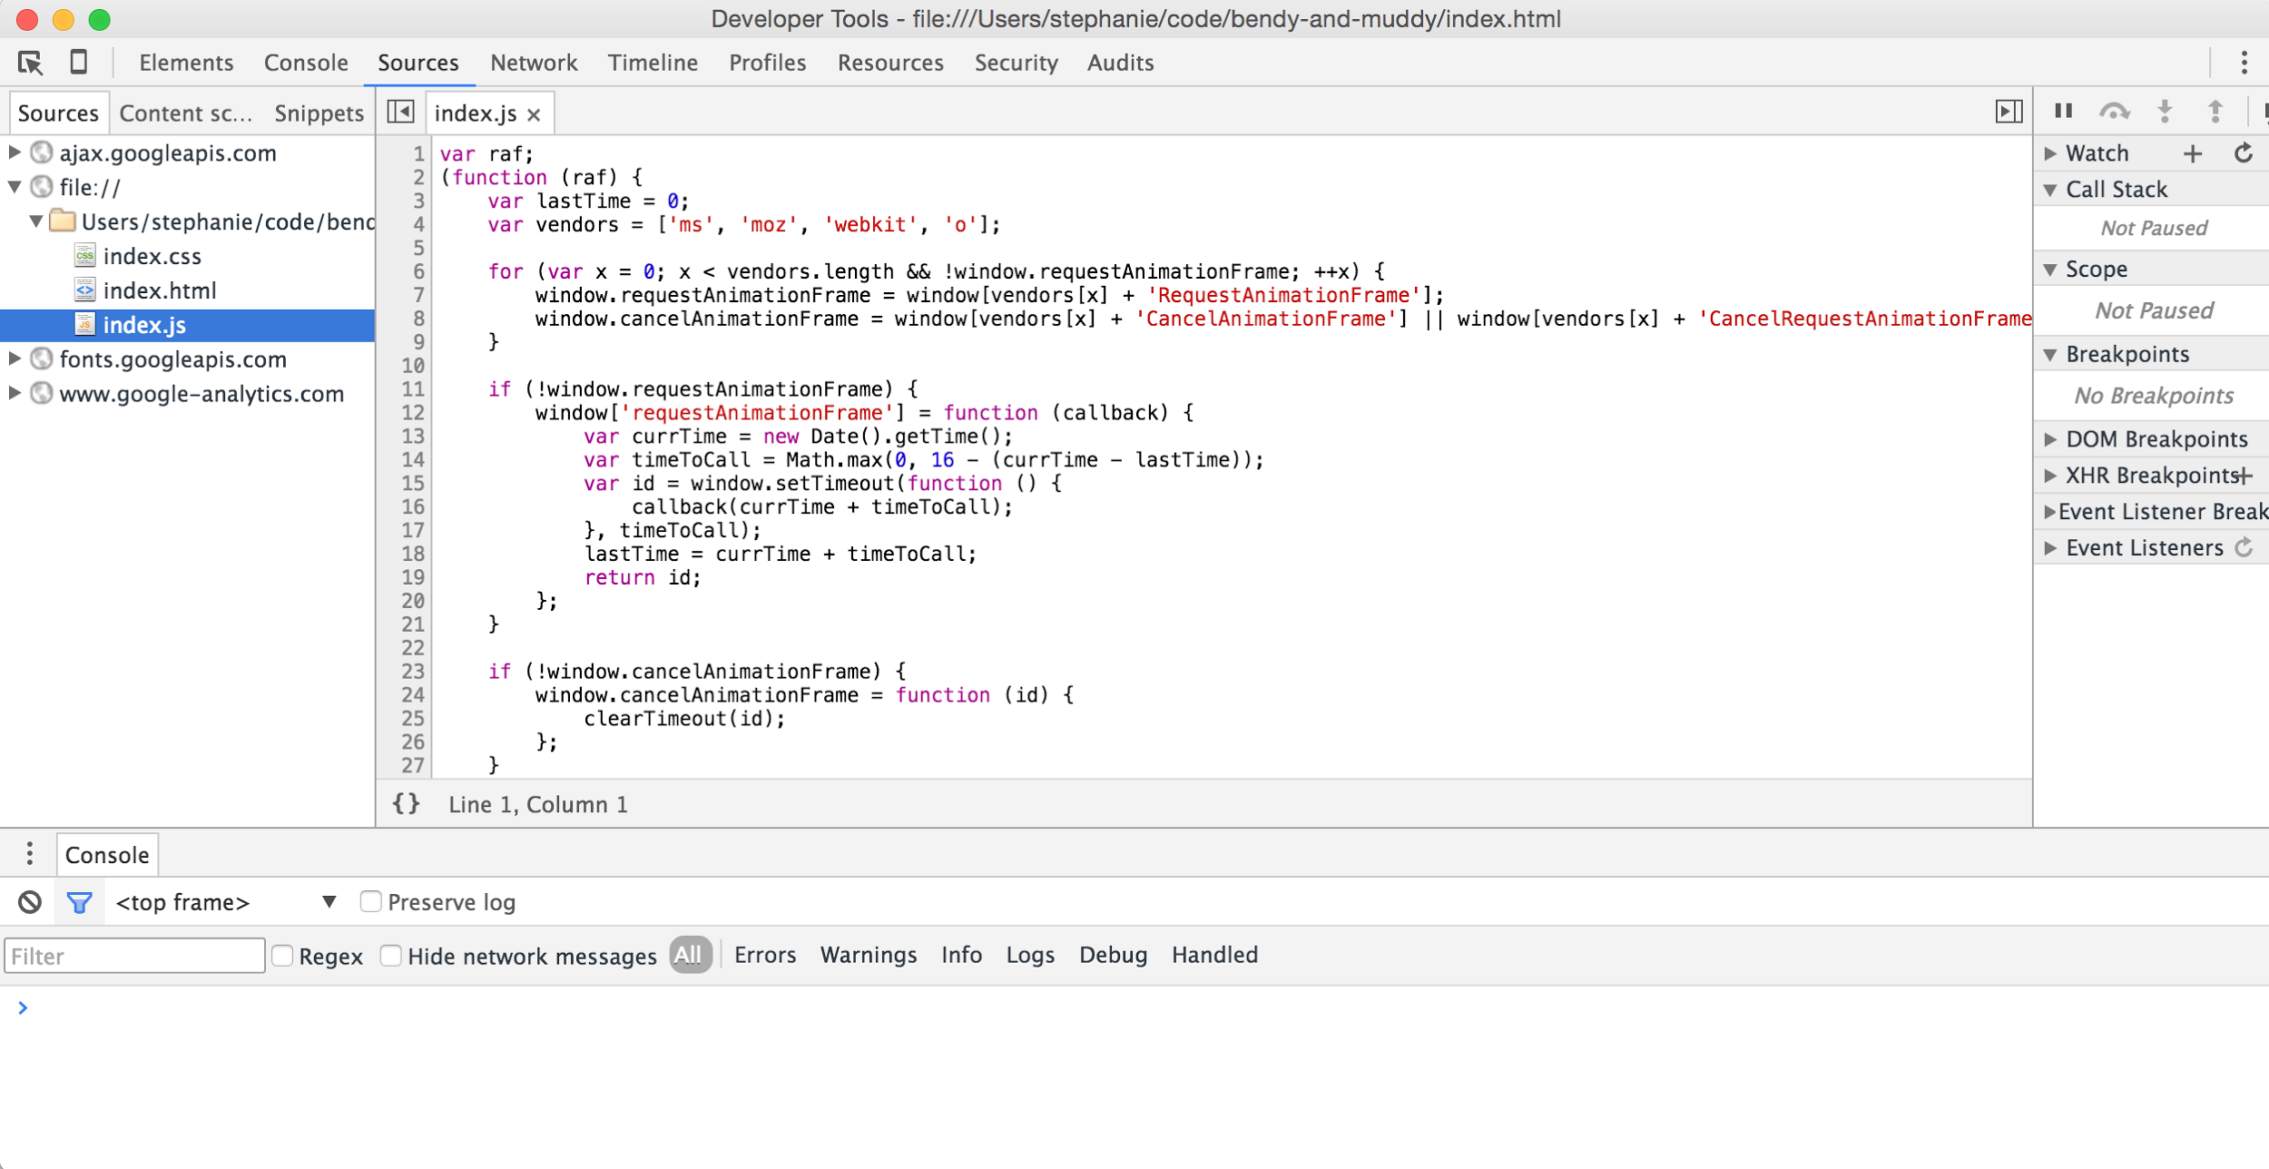
DEV TOOLS ARE YOUR FRIEND
Notes:
Some languages (like typescript) ship with source map generators
For languages w/o a source map generator, can compile to JS then use the Closure compiler to generate source maps

Slide 22
DEV TOOLS ARE YOUR FRIEND
Use browser debugger

Slide 23
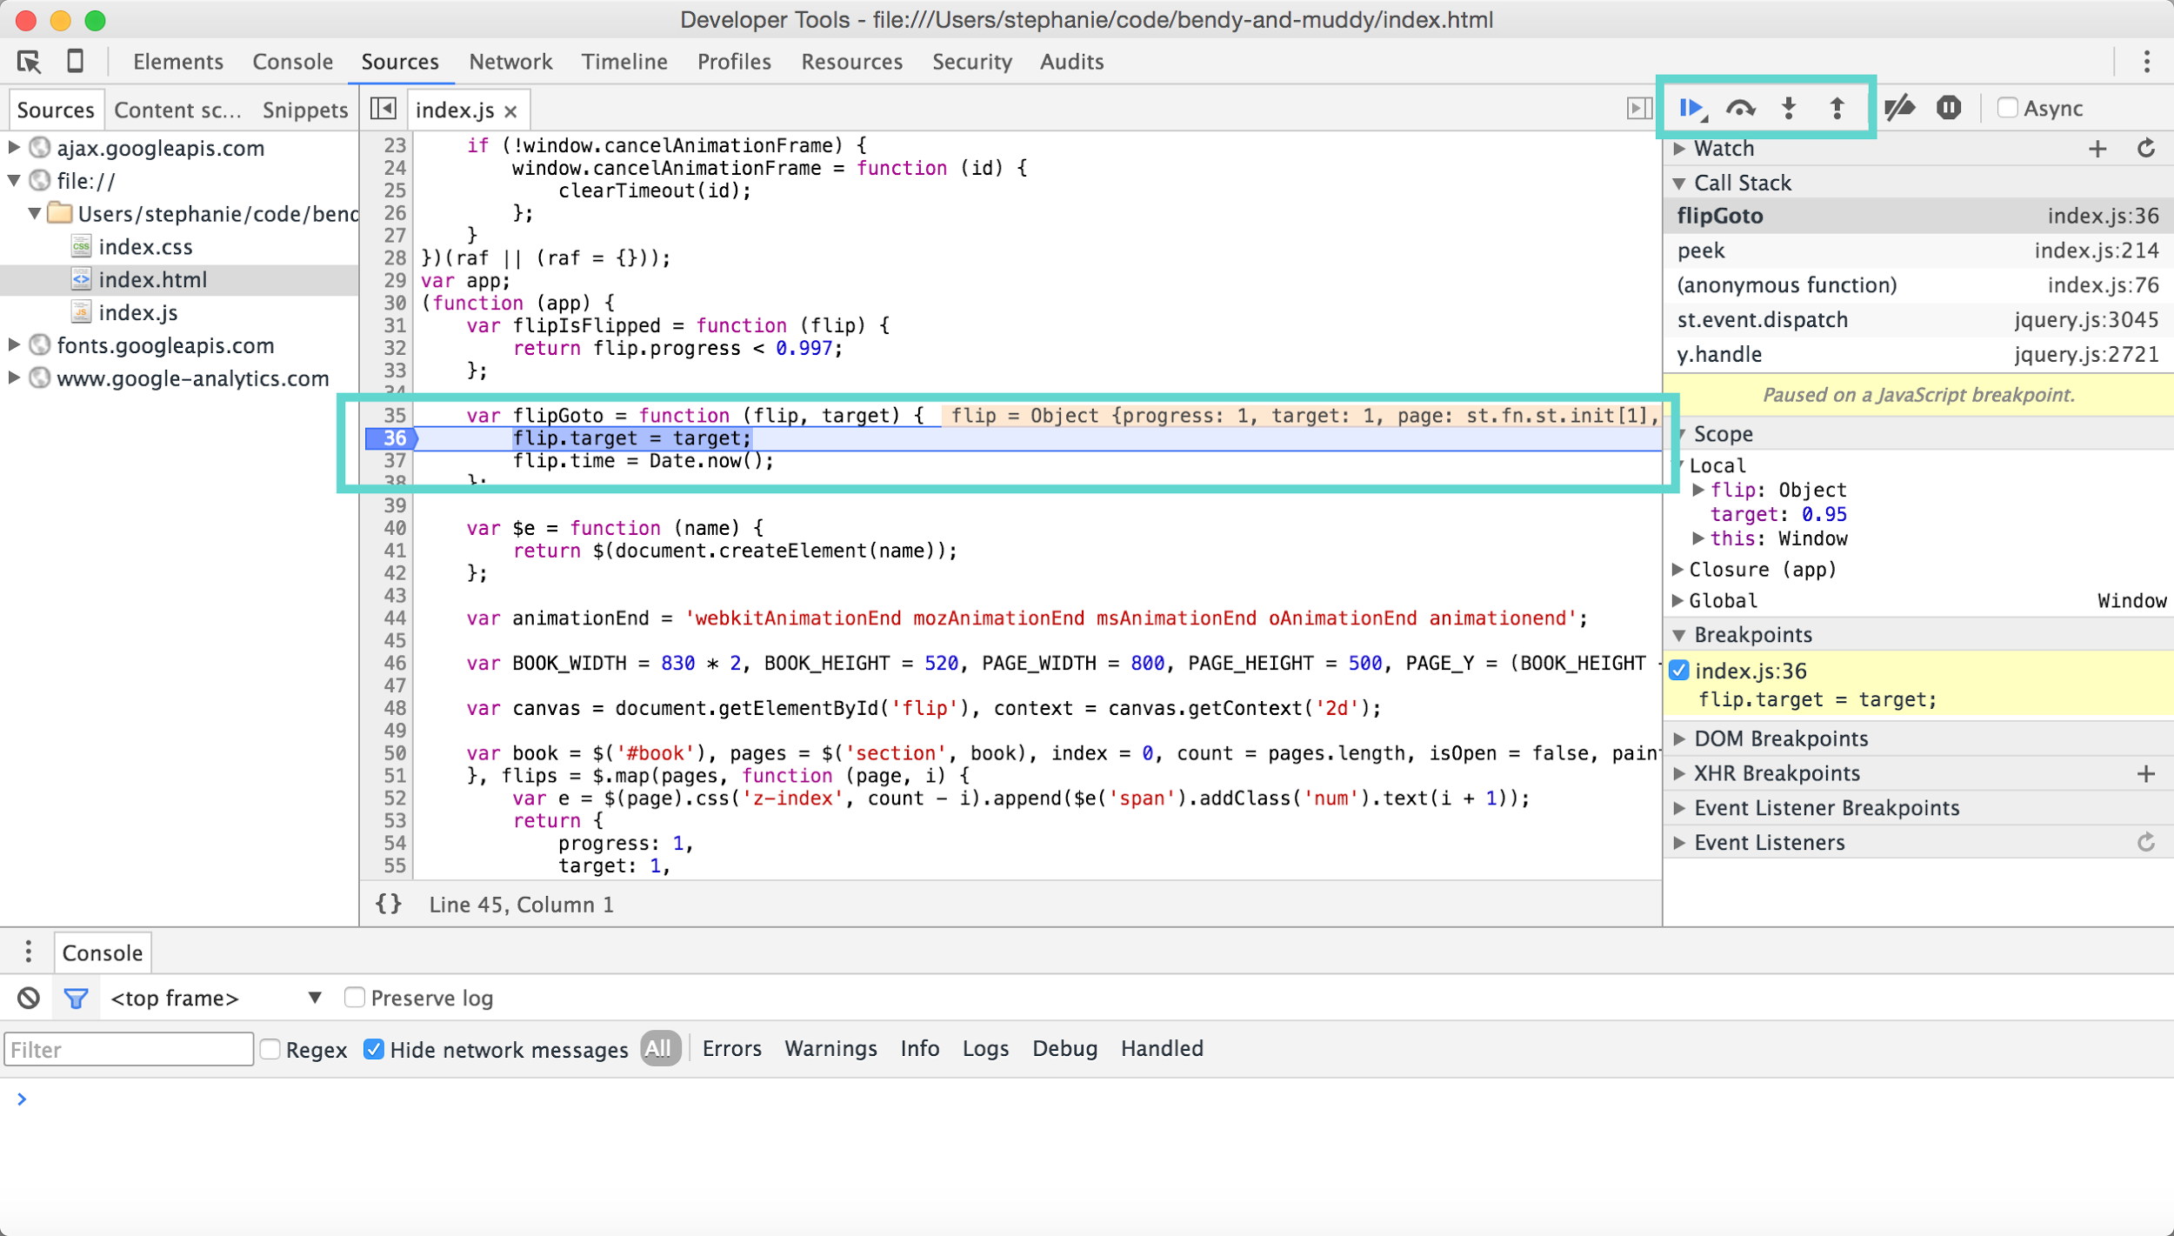
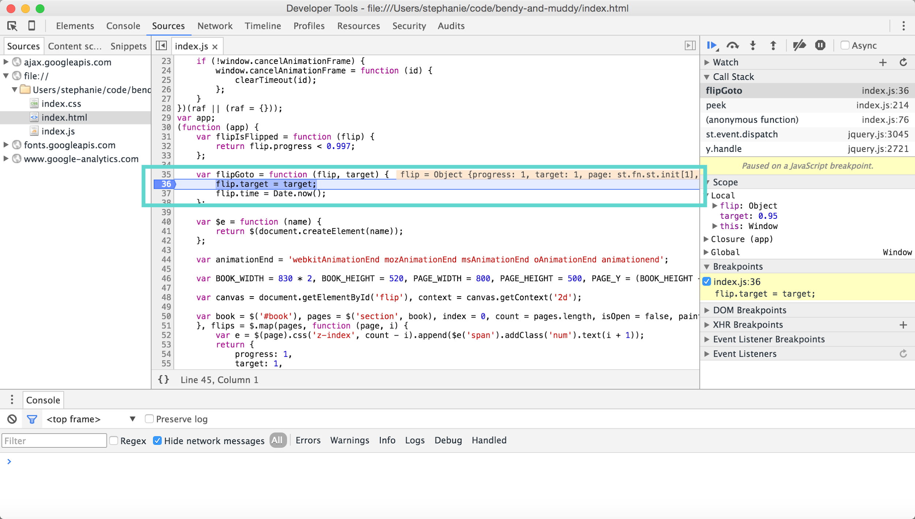
DEV TOOLS ARE YOUR FRIEND

Slide 24
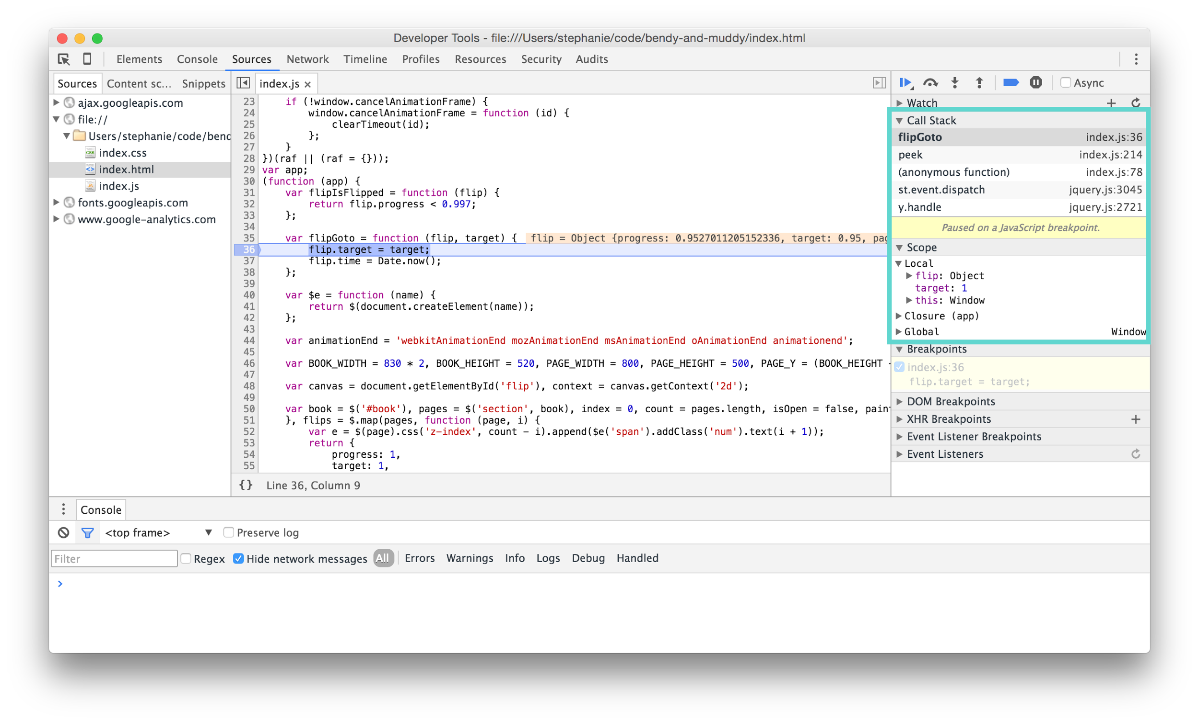
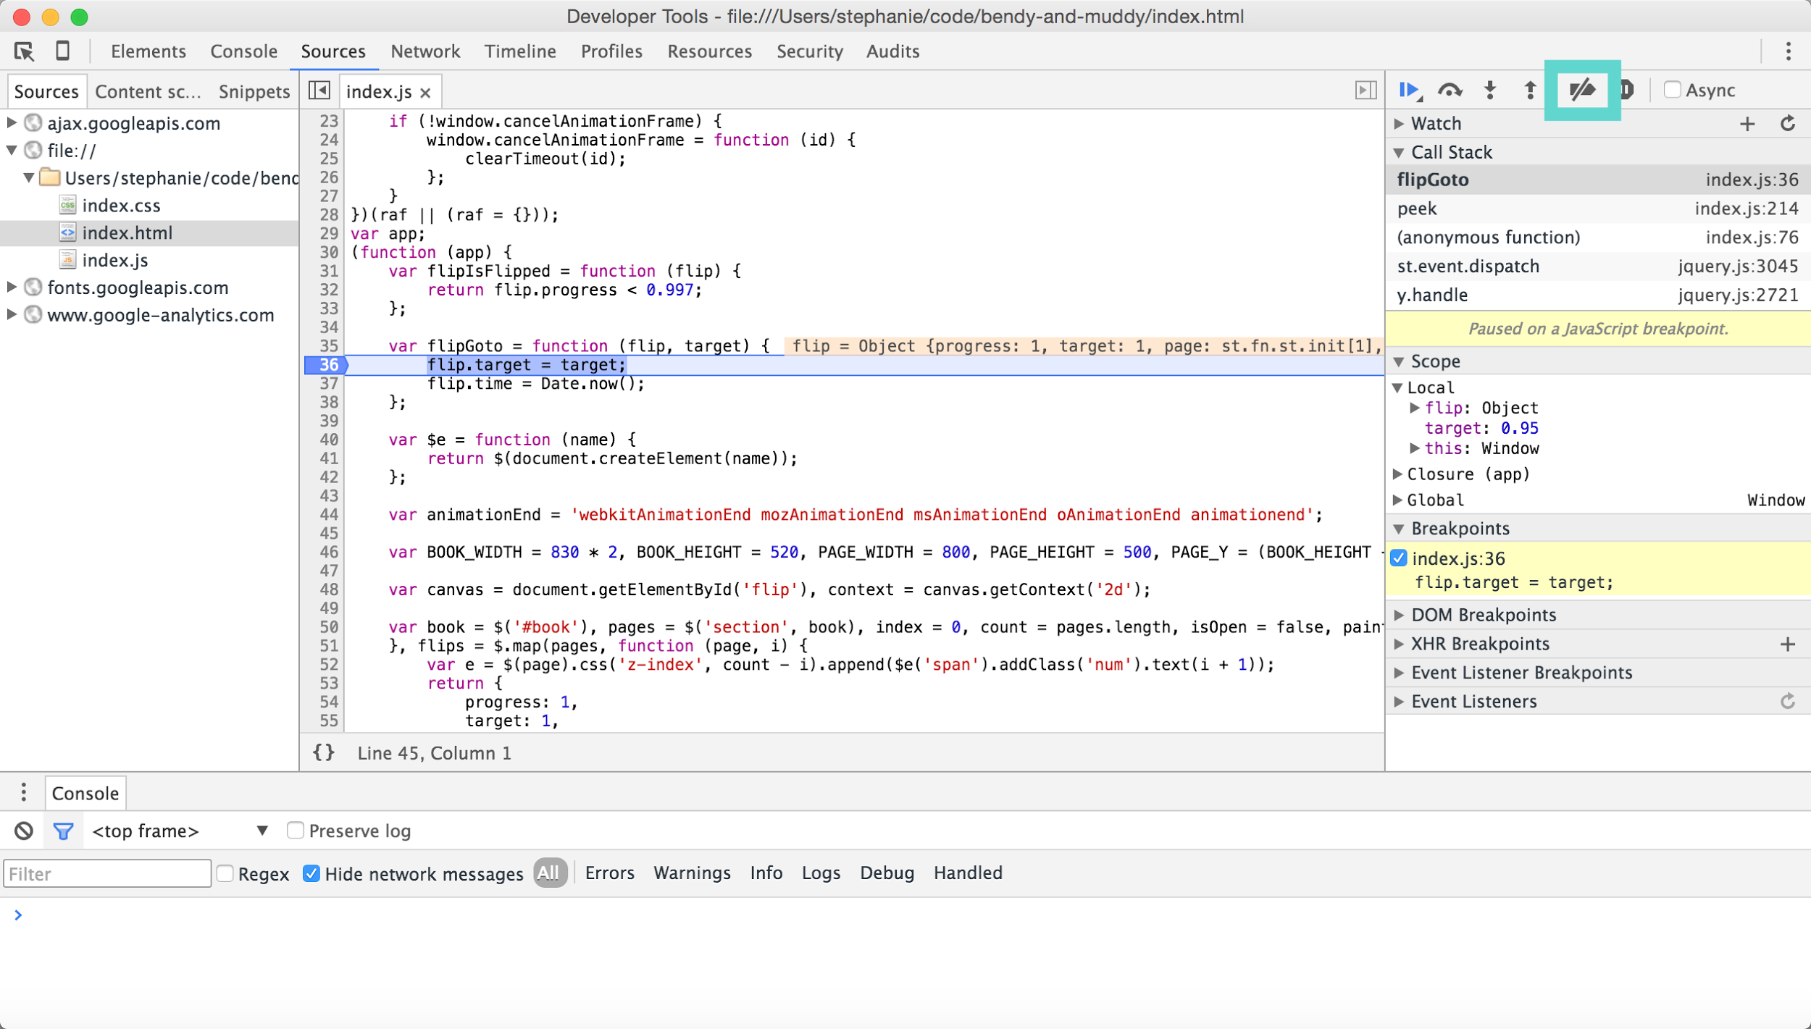
DEV TOOLS ARE YOUR FRIEND

Slide 25
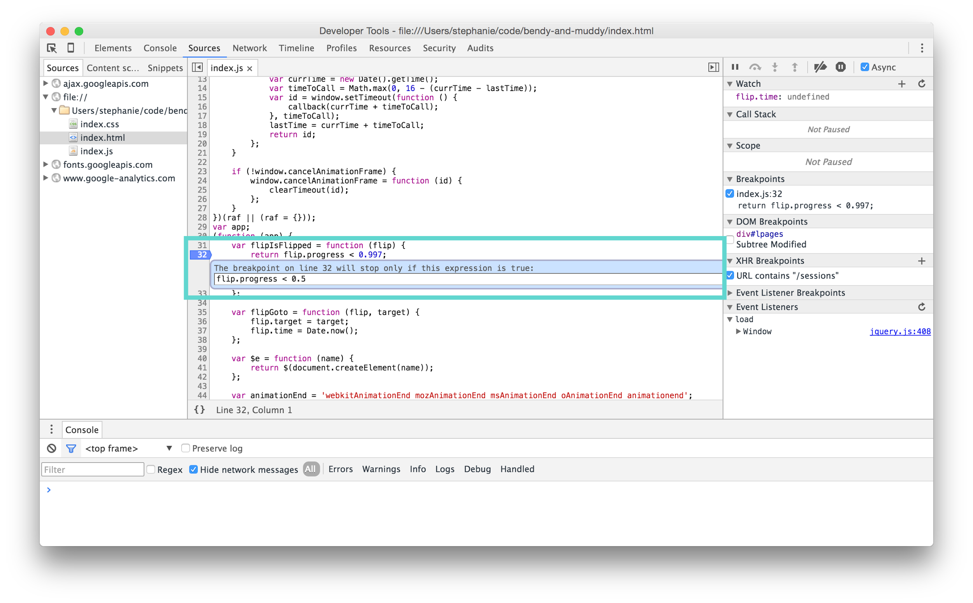
DEV TOOLS ARE YOUR FRIEND

Slide 26
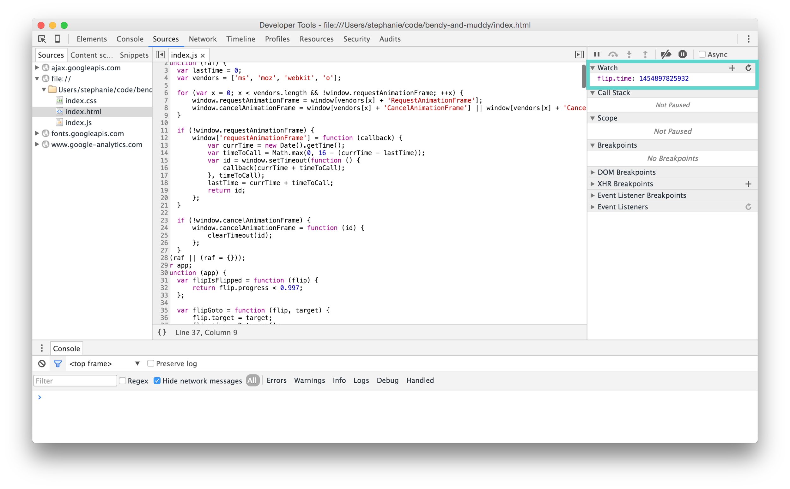
DEV TOOLS ARE YOUR FRIEND

Slide 27
DEV TOOLS ARE YOUR FRIEND
Notes:
story about not finding this button

Slide 28
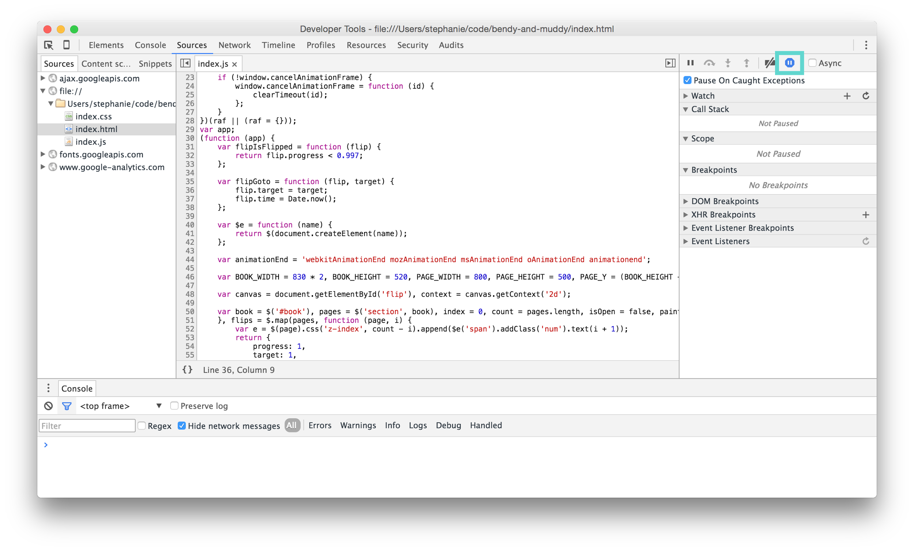
DEV TOOLS ARE YOUR FRIEND

Slide 29
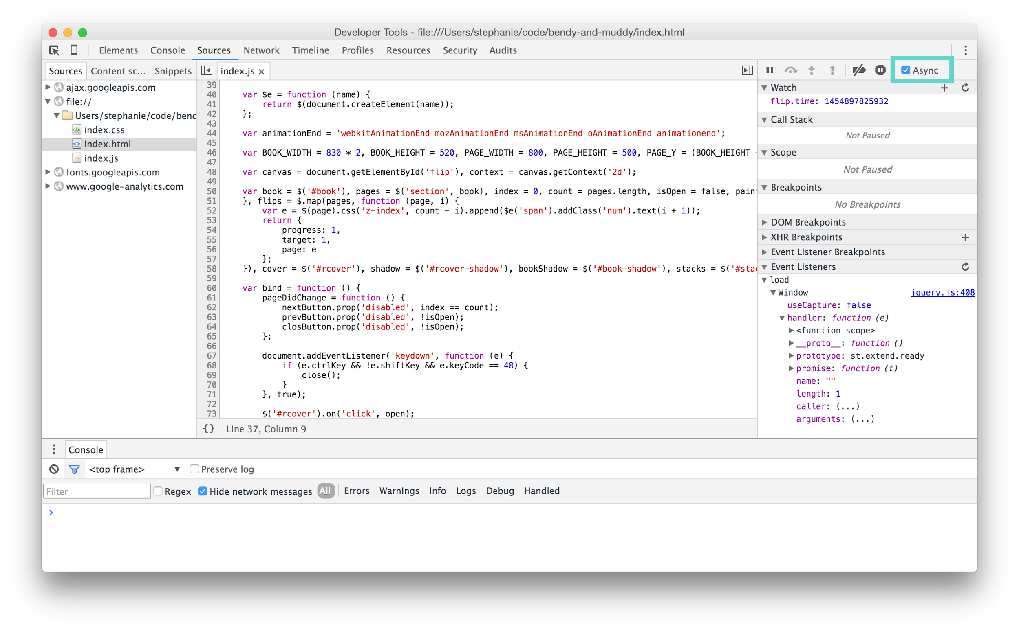
DEV TOOLS ARE YOUR FRIEND

Slide 30
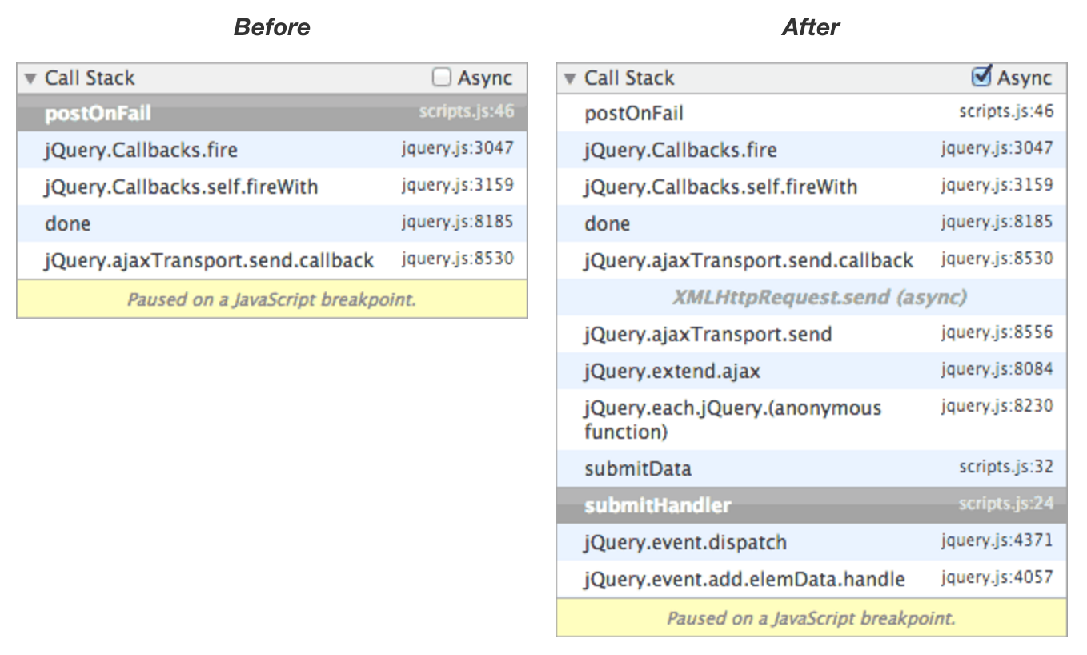
DEV TOOLS ARE YOUR FRIEND
http://www.html5rocks.com/en/tutorials/developertools/async-call-stack/

Slide 31
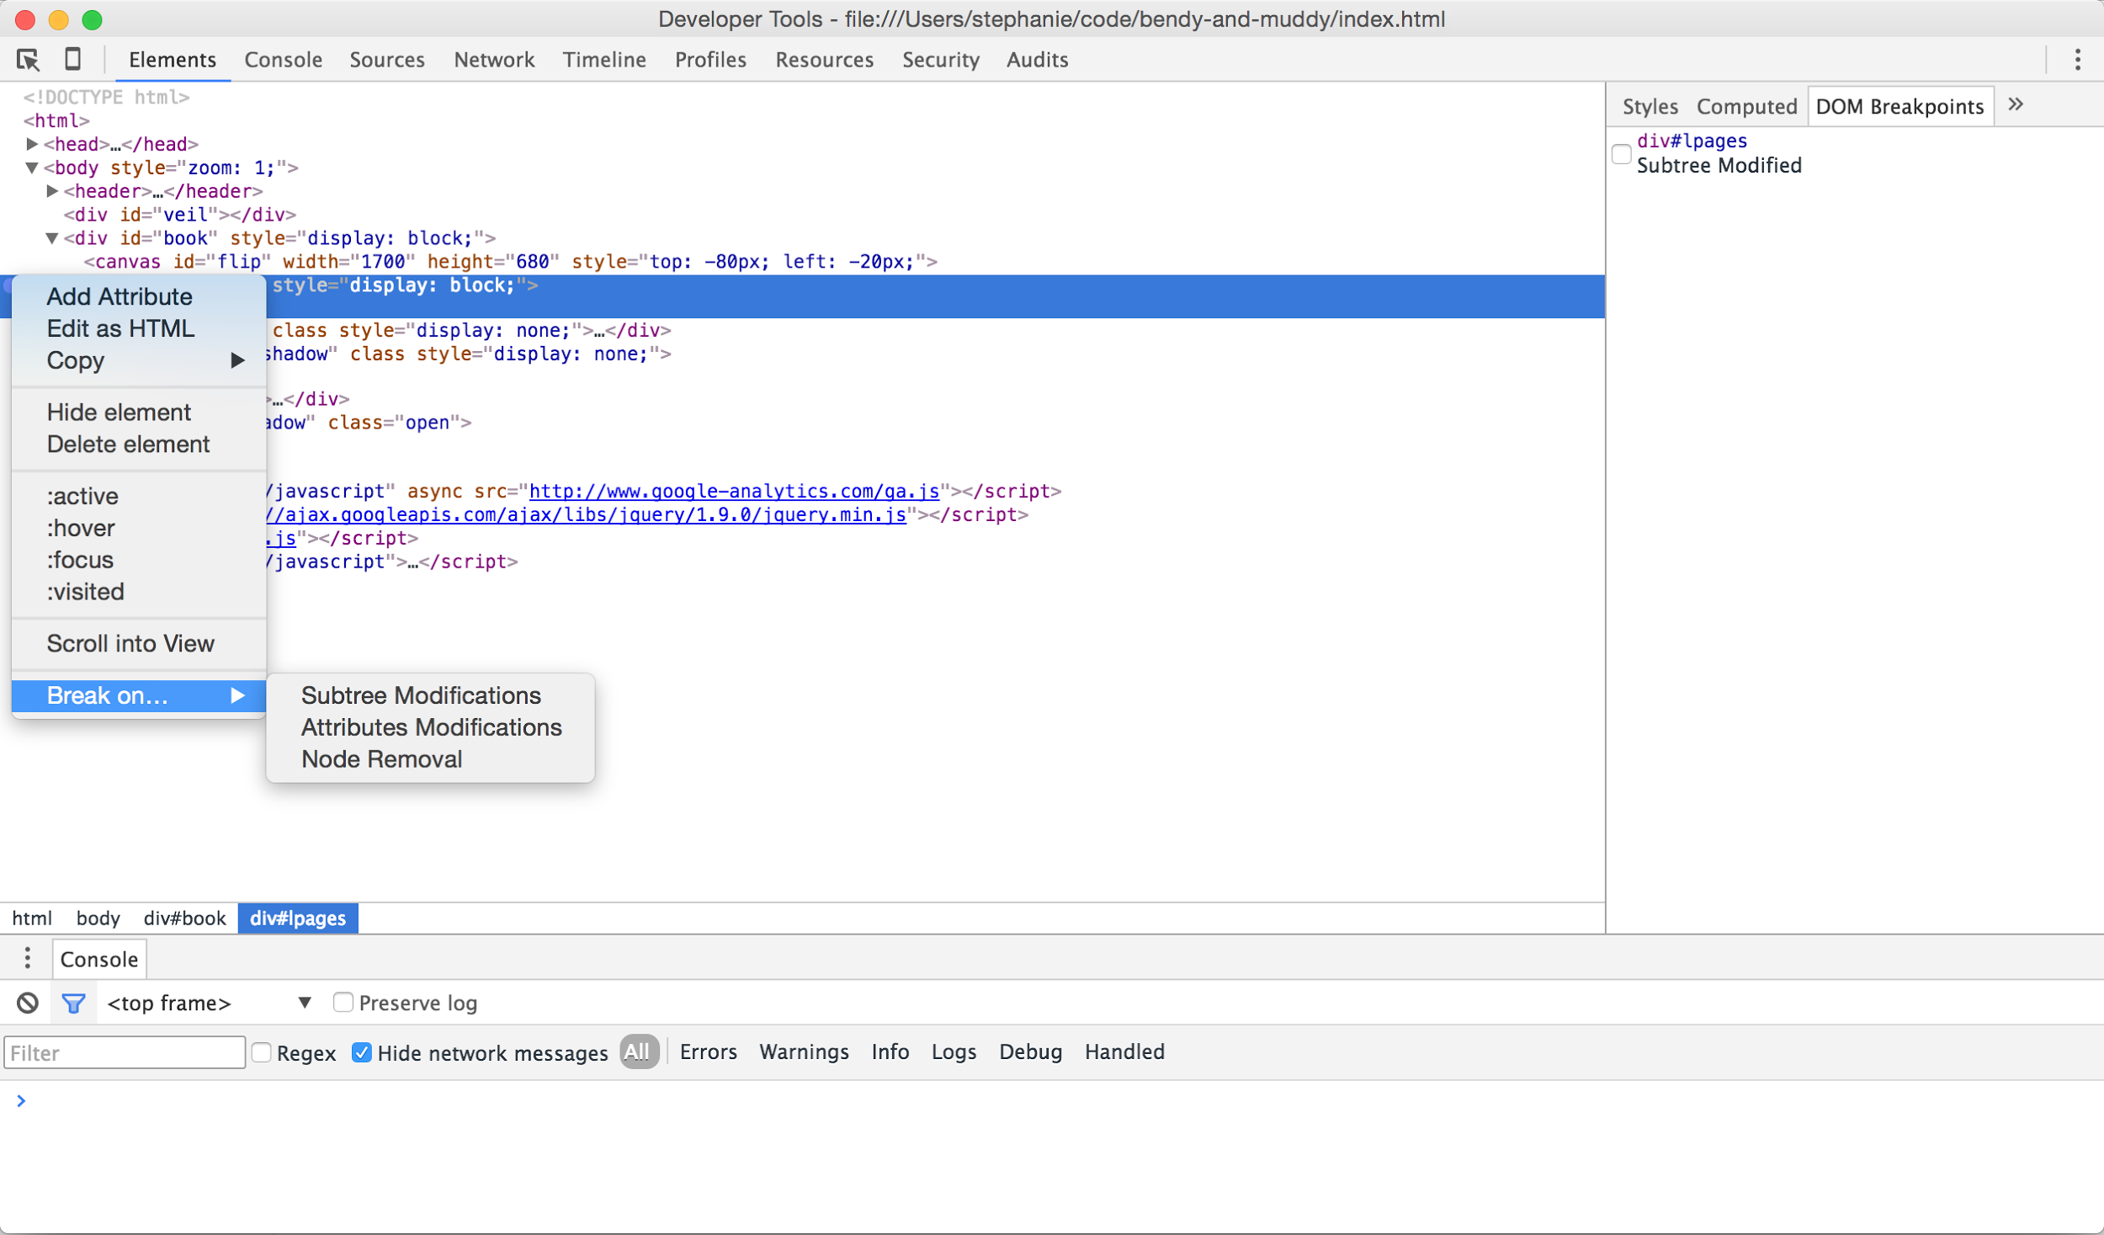
DEV TOOLS ARE YOUR FRIEND
Notes:
removing and re-adding the body on every navigation; going form server-side templates to client-side rendering

Slide 32
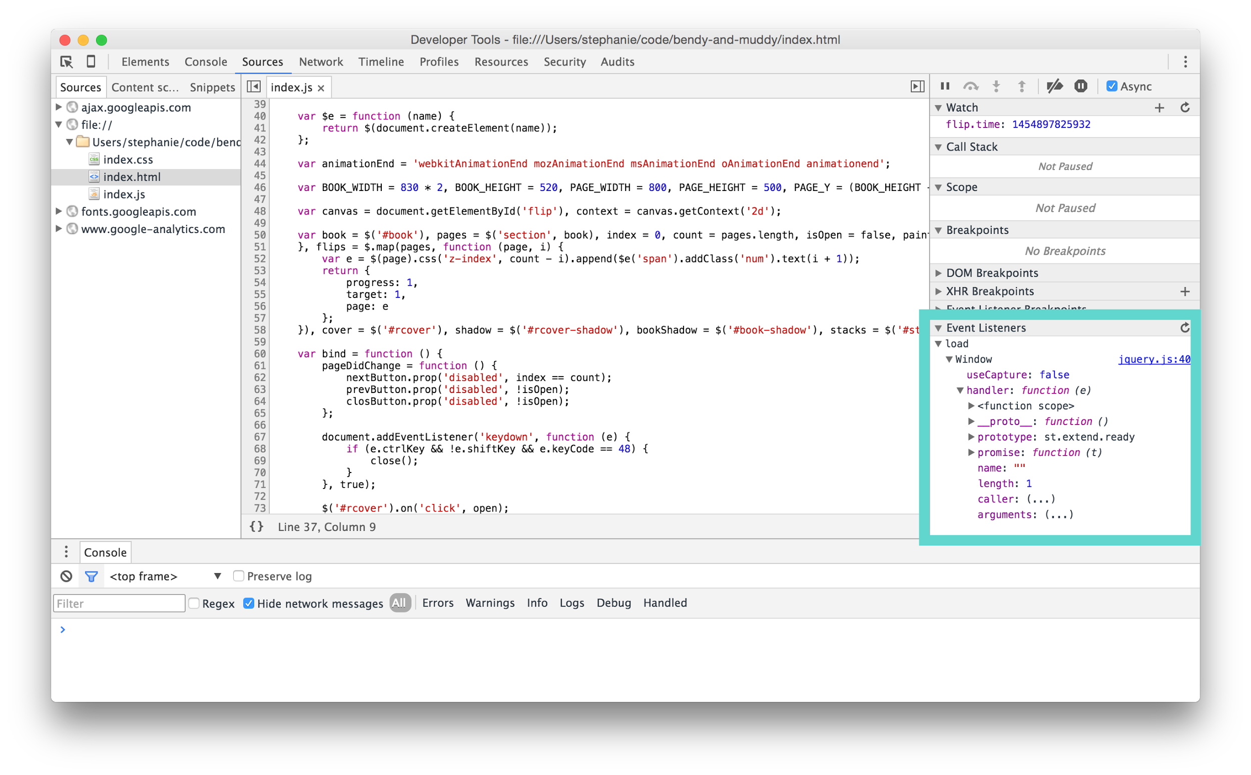
DEV TOOLS ARE YOUR FRIEND
Notes:
re-adding click handler

Slide 33
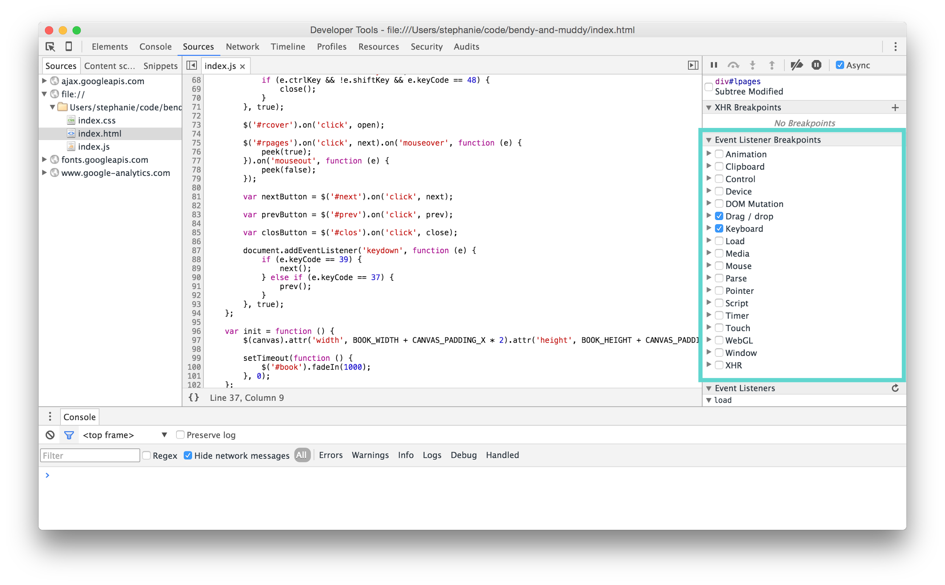
DEV TOOLS ARE YOUR FRIEND

Slide 34
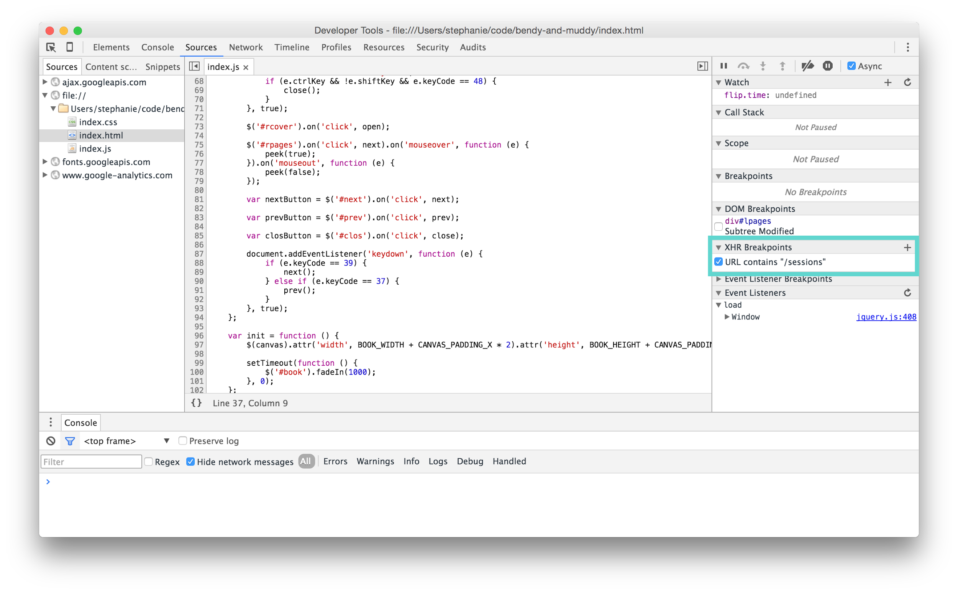
DEV TOOLS ARE YOUR FRIEND

Slide 35
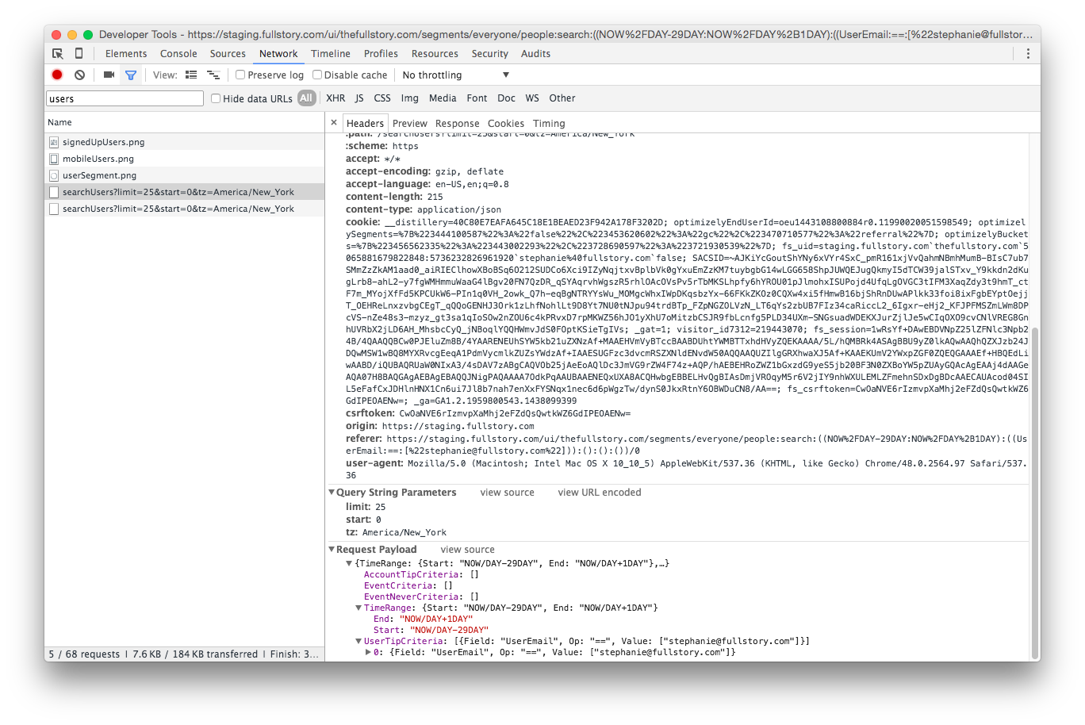
DEV TOOLS ARE YOUR FRIEND
Notes:
Speaking of XHRs, the network tab is great; can see req/rsp headers, query params, payload, etc.

Slide 36
THE BEST DEFENSE IS A GOOD OFFENSE
Repro error conditions
Notes:
Works on my machine :)
autocomplete box

Slide 37
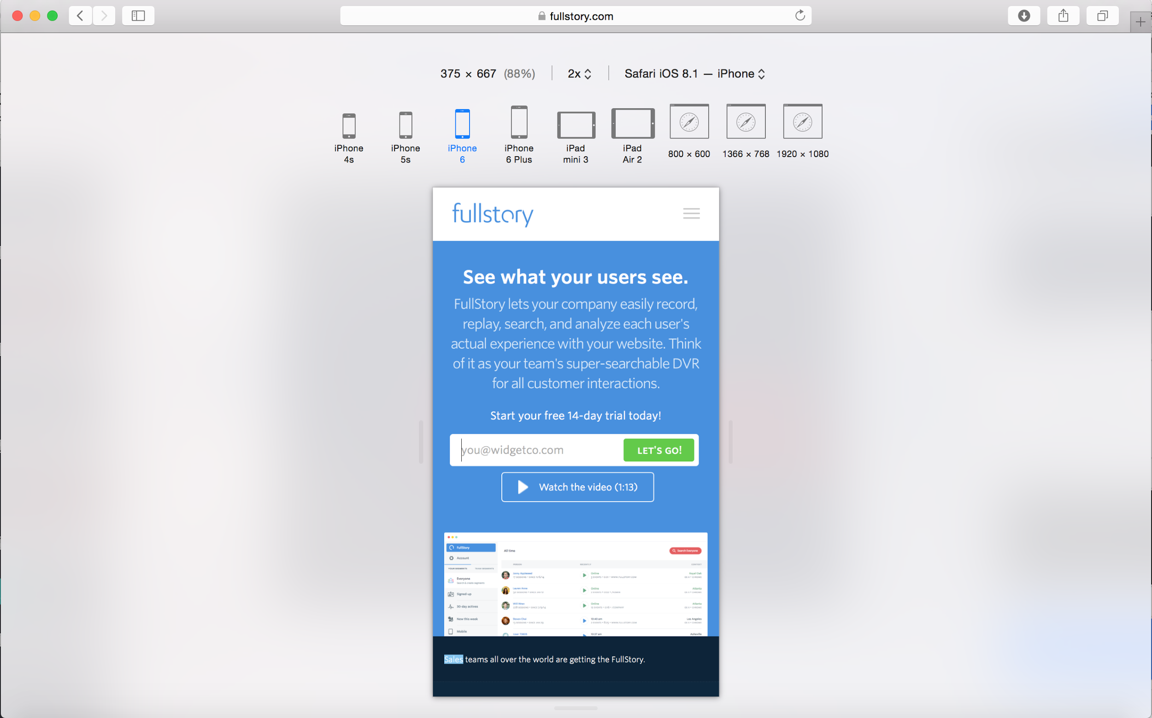
DEV TOOLS ARE YOUR FRIEND

Slide 38
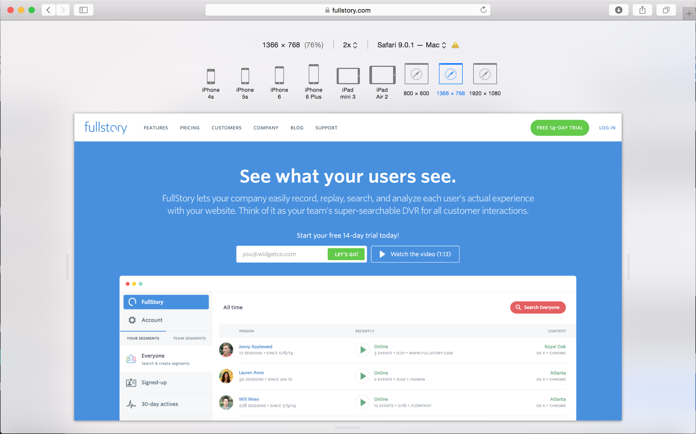
DEV TOOLS ARE YOUR FRIEND
Notes:
can’t manually set resolution in Responsive Design mode, but can use drag bars to resize dynamically

Slide 39
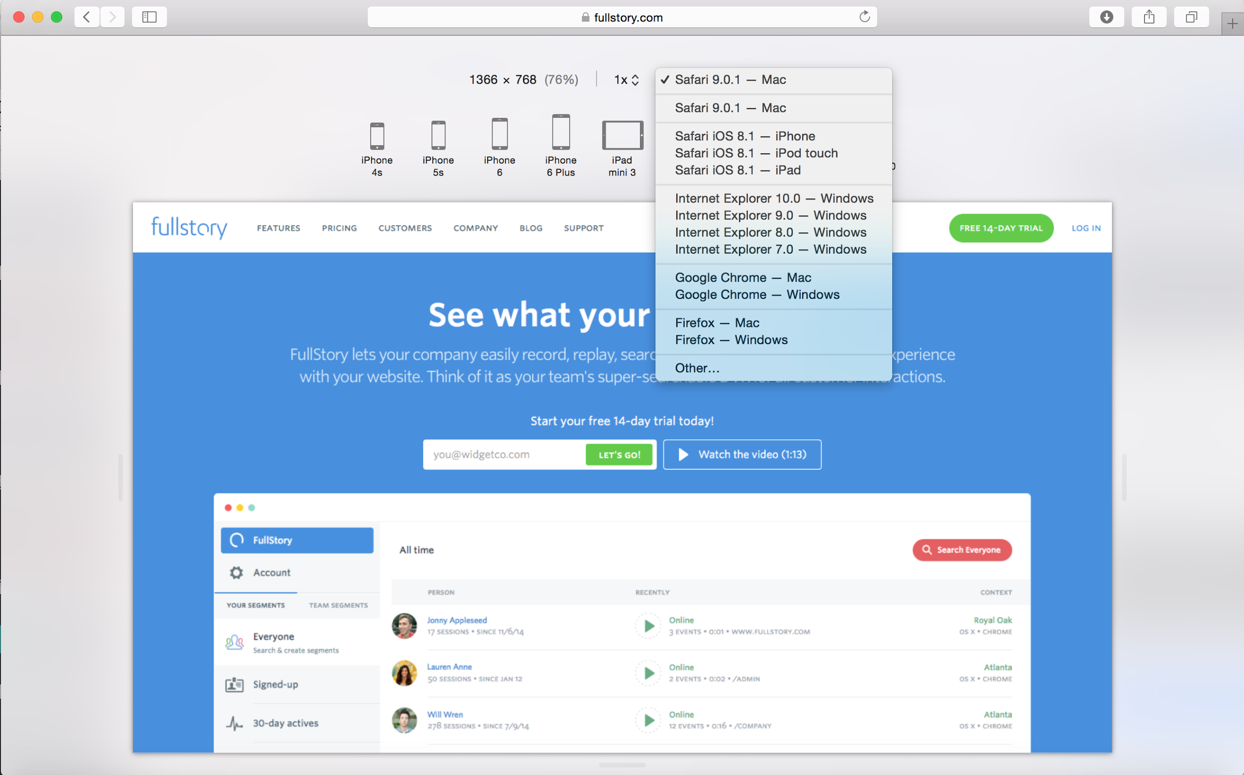
DEV TOOLS ARE YOUR FRIEND
Notes:
can enter a custom user agent string as well

Slide 40
DEV TOOLS ARE YOUR FRIEND
Add source maps
Use browser debugger
Repro error conditions

Slide 41
PROTECT YOUR INVESTMENT
Notes:
Writing code takes a lot of hard work. Don’t do it twice.

Slide 42

MY PRECIOUS

Slide 43
PROTECT YOUR INVESTMENT
Create automated tests

Slide 44
Web Automation Frameworks
Selenium/WebDriver
nightmare.js

Slide 45
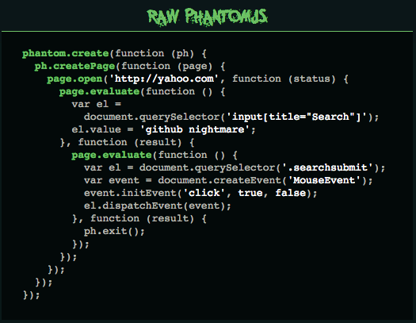
http://www.nightmarejs.org/

Slide 46
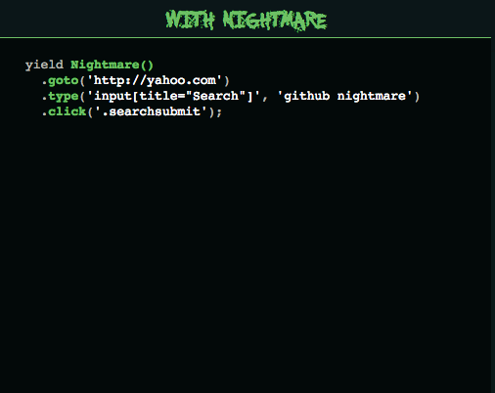
http://www.nightmarejs.org/

Slide 47
Test frameworks
Mocha
Jasmine
QUnit

Slide 48
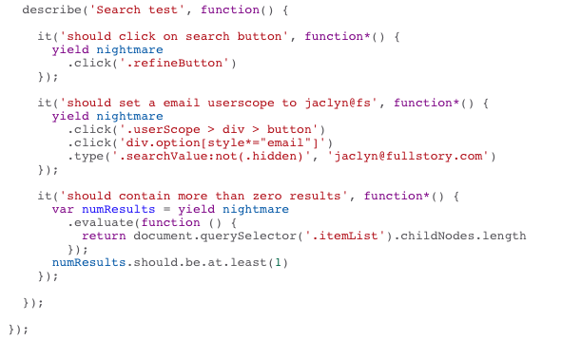
nightmare.js + Mocha
Notes:
dev who works in text pad

Slide 49

CYPRESS.IO

Slide 50
Build Automation
Buildbot
Jenkins
Grunt
Gulp

Slide 51
PROTECT YOUR INVESTMENT
Require code reviews

Slide 52
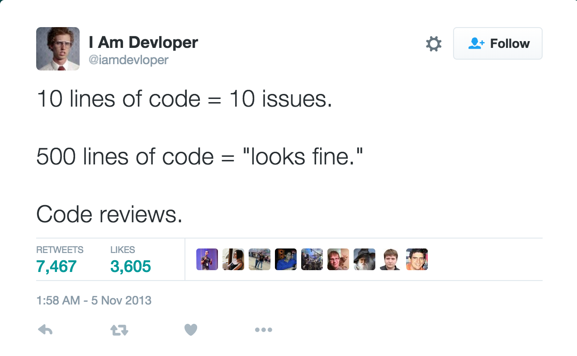
NOT THIS

Slide 53
Code Reviews FTW
Knowledge transfer
Maintain culture
Genuinely better code
Notes:
KT - makes sure 2 people see every piece of code
Culture - spread conventions across the team; maintain open honest communication among team members
Better code - easier to justify cutting corners to yourself; keep each other honest; quality and consistency

Slide 54
PROTECT YOUR INVESTMENT
Create automated tests
Require code reviews

Slide 55
DEBUGGING JS LIKE A BOSS
Start with a good offense
Dev tools are your friend
Protect your investment
Notes:
Good offense -- change languages, use CSS, optimize env
Dev tools -- source maps, Chrome debugger, responsive design view
Protect - automated testing, code reviews

Slide 56
Thanks!
QUESTIONS?
@sjbrubaker
stephanie@fullstory.com

